Slide 1
Text Similarity

Slide 2
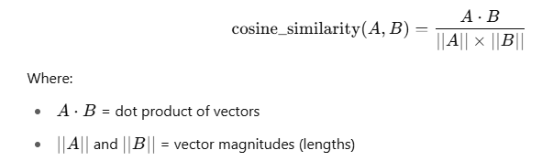
Cosine Similarity
Concept
Cosine Similarity measures how similar two texts are by angle between their vector representations.
Value range: -1 (opposite) to +1 (exactly same).
✅ If angle is 0°, cosine = 1 → Texts are identical.
✅ If angle is 90°, cosine = 0 → Texts are unrelated.
Cosine similarity between two vectors A and B:
Measures direction, not magnitude.

Slide 3
Why TF-IDF with Cosine Similarity?
Concept | Reason
TF-IDF | Converts text into numeric vectors based on important words
Cosine Similarity | Measures closeness of these vectors
Together, they let you measure text similarity mathematically!

Slide 4
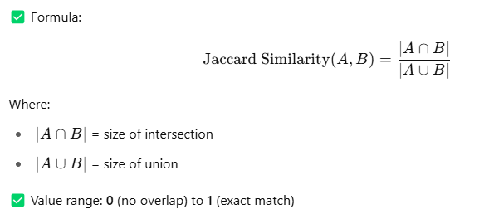
Jaccard Similarity
Concept
Jaccard Similarity measures the overlap between two sets.
How much two sets have in common versus their total unique elements.

Slide 5
Why use Jaccard Similarity?
Aspect | Jaccard
Type | Set-based overlap
Use case | Keyword matching, duplicate detection
Good for | Short texts, tag matching
Not good for | Long sentences, meaning similarity
Works best when exact words matter — not context.

Slide 6
Cosine vs Jaccard
Cosine | Jaccard
Based on vector angle | Based on keyword overlap
Good for meaning similarity | Good for keyword-based similarity
Uses TF-IDF / frequency | Uses simple sets

